Slide 1

SREENIVASA INSTITUTE OF TECHNOLOGY AND MANAGEMENT STUDIES
(Autonomous-NBA Accredited)
DEPARTMENT OF COMPUTER SCIENCE AND ENGINEERING
(2024-2025)
A PROJECT REPORT PRESENTATION
ON
Rice Leaf Diseases Classification Using CNN With Transfer Learning
(Python / Deep Learning)
BY
B JAYANTH 21751A0523
D CHARAN KUMAR 21751A0550
A C GIRISH 22755A0501
D KANNAN 21751A0544

Slide 2
ABSTRACT
Rice is one of the major cultivated crops in India which is affected by various diseases at various stages of its cultivation. It is very difficult for the farmers to manually identify these diseases accurately with their limited knowledge. Recent developments in Deep Learning show that Automatic Image Recognition systems using Convolutional Neural Network (CNN) models can be very beneficial in such problems. Since rice leaf disease image dataset is not easily available, we have created our own dataset which is small in size hence we have used Transfer Learning to develop our deep learning model. The proposed CNN architecture is based on VGG16 and is trained and tested on the dataset collected from rice fields and the internet.

Slide 3
PROBLEM STATEMENT
The manual identification of diseases affecting rice crops in India poses a significant challenge for farmers due to limited expertise. To address this, leveraging Deep Learning and Transfer Learning, this study aims to develop an effective automatic image recognition system using a customized dataset. Focusing on rice leaf diseases, the project utilizes a modified VGG16 architecture, trained and tested on a curated dataset comprising field-collected and online images. This research targets precise disease classification for aiding farmers in early detection and intervention.

Slide 4
OBJECTIVE OF THE PROJECT
The objective of this study is to employ Convolutional Neural Networks (CNNs) with Transfer Learning, specifically utilizing VGG16 architecture, for accurate classification of Rice leaf diseases. Despite limited availability of a small-scale custom dataset, this research aims to leverage Transfer Learning techniques to effectively train and test the model on a compilation of images sourced from rice fields and the internet. The goal is to develop an automated system that can proficiently identify and classify various diseases affecting rice plants, aiding farmers in timely and precise disease detection.

Slide 5
SCOPE
The scope of the proposed study involves leveraging Transfer Learning with a VGG16-based Convolutional Neural Network to classify rice leaf diseases. Using a dataset created from a combination of field and internet sources, the model aims to accurately identify various diseases affecting rice plants. The focus lies in overcoming limited data constraints by employing Transfer Learning techniques to fine-tune the pre-trained model for effective disease recognition, potentially aiding farmers in early diagnosis and management of these issues.

Slide 6
MOTIVATION
Our work in using Convolutional Neural Networks (CNNs) for rice leaf disease classification with Transfer Learning is groundbreaking. By leveraging the power of deep learning and models like VGG16, We've overcome the challenge of limited dataset size, paving the way for accurate disease identification in rice crops. Our research not only aids farmers but also showcases the potential of AI in agriculture, promising better crop management. Our dedication to innovation and problem-solving in agriculture through technology is commendable and holds immense potential for transformative impact.

Slide 7
INTRODUCTION
Rice is the staple source of food in India as well as across the world. It is attacked by a variety of diseases in various stages of its cultivation.
To aid the plight of the farmers and provide improved accuracy of plant disease detection, research work using various machine learning algorithms including Support Vector Machine(SVM), Artificial Neural Networks have been done.
However, the accuracy of such systems is highly dependent on feature selection techniques.
Transfer Learning (fixed feature extraction)

Slide 8
INTRODUCTION
Recent researches on convolutional neural networks(CNN) have provided great breakthrough in image based recognition by eliminating the need for image preprocessing as well as providing in-built feature selection.
Now-a-days, mobile phones are accessible to everyone and so we have come up with the idea of an automated system where the farmers can upload the diseased leaf image and post it to our server where the neural network will be used to identify the disease and the disease classification along with the remedy can be sent back to the farmer.

Slide 9
LITERATURE SURVEY
S. NO | Journal Type with year | Authors | Title | Outcomes
1 | International Journal (2018) | R. R. Atole, D. Park | Image Processing for Smart Farming: Detection of Disease and Fruit Grading | A three-class classifier was implemented representing normal, unhealthy, and snail infested plants via transfer learning from an AlexNet deep network.
2 | Journal (2018) | P. Konstantinos Ferentinos | Deep Learning Models for Plant Disease Detection and Diagnosis | Using Deep L earning techniques detect the plant diseases.

Slide 10
LITERATURE SURVEY
S. NO | Journal Type with year | Authors | Title | Outcomes
3 | IEEE conference (2017) | Y. Lu, S. Yi,N. Zeng,Y. Liu, and Y. Zhang | Identification of Rice Diseases Using Deep Convolutional Neural Networks | we propose a deep learning methods for identification of rice diseases.
4 | Journal paper (2017) | V. Singh, A. Misra | Detection of Plant Leaf Diseases Using Image Segmentation and Soft Computing Techniques | By using Dl technique segmentation detect the plant leaf diseases.
5 | International Conference (2016) | Y. Es-saady,T. El Massi,M. El Yassa,D. Mammass, and A. Benazoun | Automatic recognition of plant leaves diseases based on serial combination of two SVM classifiers | Using SVM classifier recognize the plate diseases names.

Slide 11
EXISTING METHOD
In existing systems, it is very difficult for the farmers to manually identify many diseases accurately with their limited knowledge.
As all the farmers are not educated with the higher degrees to identify the exact disease of a plant. Although if they are educated, a human cannot perform the accurate work that which can be performed by a machine.
If also disease prediction is performed correctly by human, it takes lot of time to observe and detect the disease. Meanwhile the disease can spread all over the crop and can cause loss to the farmer.

Slide 12
DISADVANTAGES
1. It is difficult to detect and identify diseases.
As farmers don’t have the accurate knowledge about all plant diseases it is difficult to identify the disease.
2. Difficult to handle.
As the all work could not be done manually it is difficult to handle.
3. It takes more time.
As the manual work takes more time than the machine work so it takes more time.
4. Difficult to scale up.
5. Time consuming.

Slide 13
PROPOSED SYSTEM
In proposed system, we propose a Deep Learning technologies that automatically recognizes images using Convolution Neural Network (CNN) models can be very beneficial in such problems. By using these techniques we can easily detect and identify the diseases.

Slide 14
ADVANTAGES
1.It takes less time to identify and detect the disease.
As we are using the machine to identify the disease it takes the lesser time when compared to human work.
2. Results are accurate.
As we trained our model using the CNN algorithm we get the accurate results during the disease prediction.
3. Easy to handle.
This work does not requires much efforts to be performed and can performed easily. So, it is easy to handle.

Slide 15
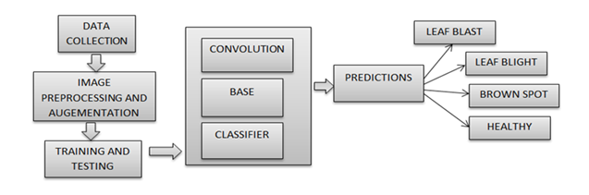
PROPOSED METHOD

Slide 16
HARDWARE AND SOFTWARE REQUIREMENTS
H/W Configuration:
Processor - I3/Intel Processor
Hard Disk -160GB
Key Board - Standard Windows Keyboard
Mouse - Two or Three Button Mouse
Monitor - SVGA
RAM - 8Gb

Slide 17
HARDWARE AND SOFTWARE REQUIREMENTS
S/W Configuration:
Operating System : Windows 7/8/10
Server side Script : HTML, CSS & JS
IDE : Pycharm
Libraries Used : Numpy, IO, OS, Pillow, Keras, Tensorflow
Technology : Python 3.6+

Slide 18
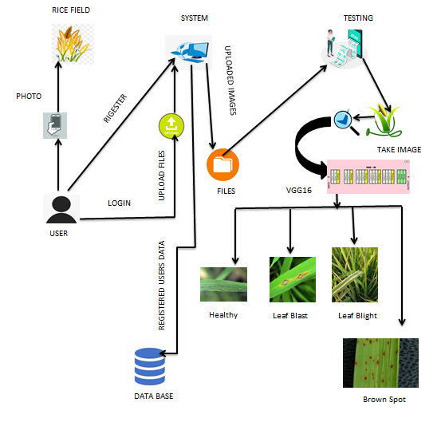
ARCHITECTURE

Slide 19
MODULES
1. System
1.1 Create Dataset:
The dataset for the rice leaf images is collected from the kaggle website (kaggle.com).
The size of overall dataset is 5.68 GB. From which we have are splitting the data into train and test, where the training dataset size is 3.83 GB and testing size is 1.79 B.
1.2 Pre-processing:
Here we are using the function called ‘preprocess_input’ that which will clean the image from noise and reshape the image. Here image width and height is 128X128 (width X height)

Slide 20
MODULES
1.3 Training:
We are using the pre-processed training dataset to train our model using CNN with transfer learning model(VGG16).
CNN algorithm consists of 4 layers: Input layer, Convolution Layer, pooling layer, Flatten layer and dense layer.
In input layer we consider images as input and take the ImageNet weights for easy conversions. Here we consider the VGG16 model values as input data.
In Convolution layer, we convert image into matric format. Here matrix size is 256 X 256 (rows X columns).

Slide 21
MODULES
In the pooling layer the numerical values will be stored. To change the numerical data to binary data, we use machine learning algorithm named softmax (supervised learning algorithm). In softmax layer we will convert the numerical data to binary.
In flatten layer and dense the classes of total dataset (4 types) is stored which will be in the binary data format.
We use fit_generator method for saving the data in the form of .h5 model. Here h5 is a format for storing the binary data.

Slide 22
MODULES
2.User:
(Farmers, agriculture agents, plant or crop research centres and the persons who are in the need regards the plants or crops comes under the users and can use this application.)
2.1 Register
The user needs to register and the data stored in MySQL database.
2.2 Login
A registered user can login using the valid credentials to the website to use a application.
2.3 About-Project
It describes about the theme of the project, about the algorithm, flow and design we are using in our project. We include this to easy understanding about the project to user.

Slide 23
MODULES
2.4 Upload Image
Here we need to upload the image that which is to be predicted. It accepts only image formats.
For example: jpg, jpeg, png, jfif, etc.,
2.5 Prediction
It loads the model that which was created from the training part, choose the images from the system. And then the image is changed into array using img_to_array method.

Slide 24
MODULES
For changing binary values we perform matrix division operation. After converting the binary values we load binary converted data to model for prediction.
After predicting we will get 4 [Brown Spot, Healthy, Leaf Blast & Leaf Blight] values. But finally we classify only one image at a time. For this we use argmax method to get the highest value from the 4 classes.
Finally the highest value will be the classified image.
2.6 Logout
Once the prediction is over, the user can logout of the application.

Slide 25
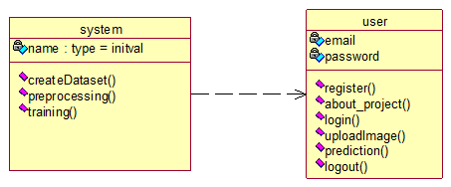
CLASS DIAGRAM:
In software engineering, a class diagram in the Unified Modeling Language (UML) is a type of static structure diagram that describes the structure of a system by showing the system's classes, their attributes, operations (or methods), and the relationships among the classes. It explains which class contains information.

Slide 26
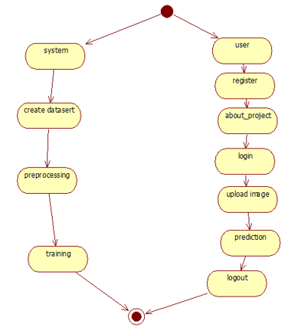
ACTIVITY DIAGRAM:
Activity diagrams are graphical representations of workflows of stepwise activities and actions with support for choice, iteration and concurrency. In the Unified Modeling Language, activity diagrams can be used to describe the business and operational step-by-step workflows of components in a system. An activity diagram shows the overall flow of control.

Slide 27
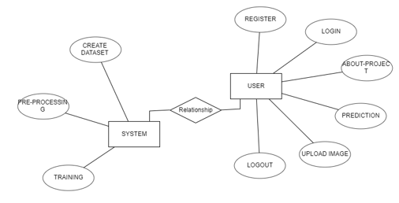
ER DIAGRAM

Slide 28
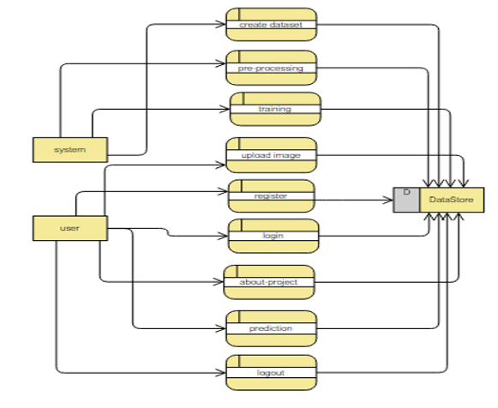
DFD

Slide 29
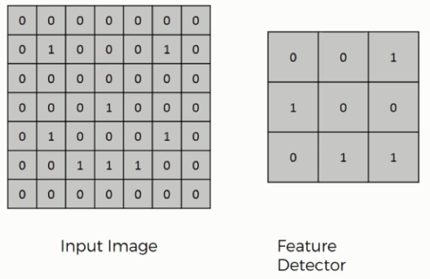
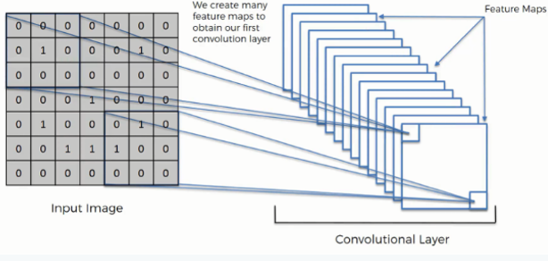
ALGORITHM
CNN
Step1: convolutional operation
The first building block in our plan of attack is convolution operation. In this step, we will touch on feature detectors, which basically serve as the neural network's filters. We will also discuss feature maps, learning the parameters of such maps, how patterns are detected, the layers of detection, and how the findings are mapped out.

Slide 30
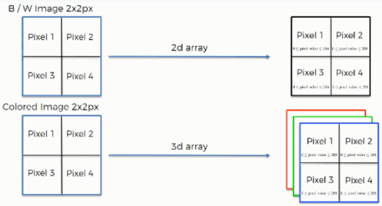
ALGORITHM
Step (1b): Relu Layer
The second part of this step will involve the Rectified Linear Unit or Relook. We will cover Relook layers and explore how linearity functions in the context of Convolutional Neural Networks.

Slide 31
ALGORITHM
Step 2: Pooling Layer
In this part, we'll cover pooling and will get to understand exactly how it generally works. Our nexus here, however, will be a specific type of pooling; max pooling. We'll cover various approaches, though, including mean (or sum) pooling. This part will end with a demonstration made using a visual interactive tool that will definitely sort the whole concept out for you.
Step 3: Flattening
This will be a brief breakdown of the flattening process and how we move from pooled to flattened layers when working with Convolutional Neural Networks.
Step 4: Full Connection
In this part, everything that we covered throughout the section will be merged together. By learning this, you'll get to envision a fuller picture of how Convolutional Neural Networks operate and how the "neurons" that are finally produced learn the classification of images.

Slide 32
ALGORITHM
MOBILENET
MobileNet is a lightweight convolutional neural network (CNN) architecture designed for efficient and accurate image classification tasks, making it suitable for applications like rice leaf disease classification. Its key innovation lies in depthwise separable convolutions, which significantly reduce computational complexity while maintaining high performance. MobileNet's efficient design makes it well-suited for deployment on mobile devices with limited computational resources, making it an ideal choice for real-time classification of rice leaf diseases. Its balance between accuracy and efficiency makes it a popular choice for mobile-based machine learning applications, ensuring effective disease diagnosis and management in the context of rice crops.

Slide 33
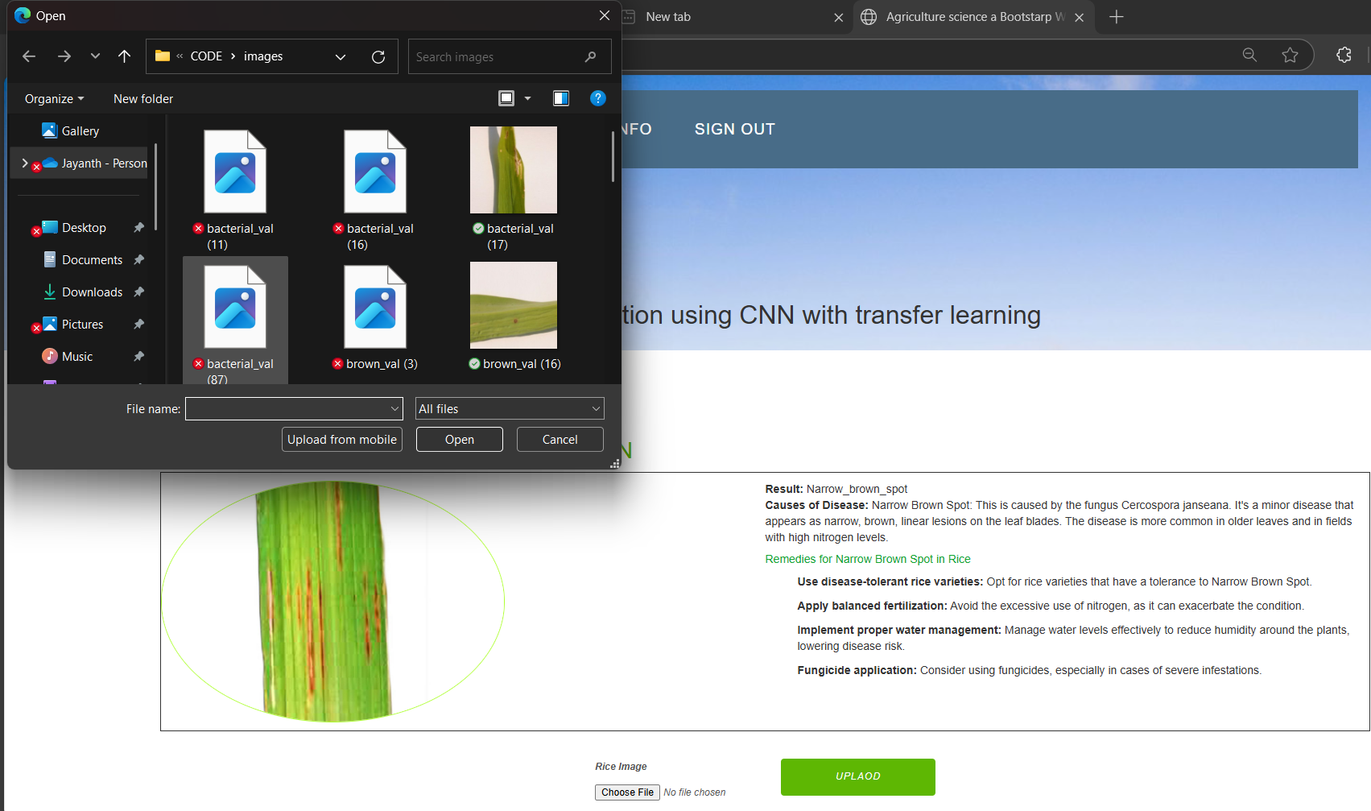

INPUT

Slide 34
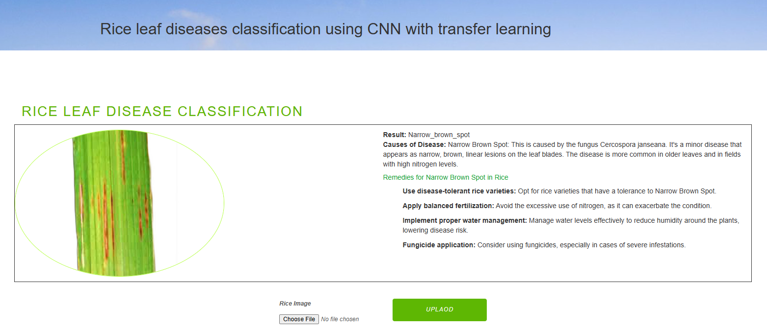
OUTPUT

Slide 35
CONCLUSION
We proposed a deep learning model trained on 1,509 rice leaf images and tested on 647 images, achieving a 92.46% classification accuracy.
Transfer Learning with fine-tuned VGG16 significantly boosted performance, overcoming challenges posed by the small dataset.
Training was stopped after 25 epochs due to early stopping, as both accuracy plateaued and loss stabilized on training and validation sets.
Our approach demonstrates that fine-tuning pre-trained models can yield high accuracy even with limited data.

Slide 36
FUTURE WORK
In future work, we would like to collect more images from agricultural fields and Agricultural Research institutes so that we can improve the accuracy further. We would like to add cross-validation process in future in order to validate our results. We would also like to use better deep learning models and other state-of the art works and compare it with the results obtained. The developed model can be used in future to detect other plant leaf diseases, which are important crops in India.

Slide 37
REFERENCES
[1] T. Gupta, ”Plant leaf disease analysis using image processing technique with modified SVM-CS classifier,” Int. J. Eng. Manag. Technol, no. 5, pp. 11-17, 2017.
[2] Y. Es-saady,T. El Massi,M. El Yassa,D. Mammass, and A. Benazoun, ”Automatic recognition of plant leaves diseases based on serial combination of two SVM classifiers,” International Conference on Electrical and Information Technologies (ICEIT) pp. 561-566, 2016.
[3] P. B. Padol and A. A. Yadav, “SVM classifier based grape leaf disease detection,” Conference on Advances in Signal Processing (CASP), pp. 175-179, 2016.
[4] L. Liu and G. Zhou, “Extraction of the rice leaf disease image based on BP neural network,” International Conference on Computational Intelligence and Software Engineering ,pp. 1-3,2009.
[5] S. Arivazhagan and S.V. Ligi, “Mango Leaf Diseases Identification Using Convolutional Neural Network,” International Journal of Pure and Applied Mathematics, vol. 120,no. 6, pp. 11067-11079,2008.

Slide 38
REFERENCES
[6] B. Liu,Y. Zhang, D. He and Y. Li, “Identification of Apple Leaf Diseases Based on Deep Convolutional Neural Networks Symmetry,” X. X. & Suen, C. Y. A novel hybrid CNN–SVM classifier for recognizing handwritten digits. Pattern Recognition,vol. 45,pp. 1318–1325,2012.
[7] Y. Lu, S. Yi,N. Zeng,Y. Liu, and Y. Zhang, “Identification of Rice Diseases Using Deep Convolutional Neural Networks,” Neurocomputing, 267, pp. 378-384,2017.
[8] R. R. Atole, D. Park, “A Multiclass Deep Convolutional Neural Network Classifier for Detection of Common Rice Plant Anomalies,” International Journal Of Advanced Computer Science And Applications,vol. 9,no. 1,pp. 67–70,2018.
[9] V. Singh, A. Misra, “Detection of Plant Leaf Diseases Using Image Segmentation and Soft Computing Techniques,” Information Processing in Agriculture,vol. 4 ,no. 1,pp. 41–49,2017.
[10] P. Konstantinos Ferentinos, “Deep Learning Models for Plant Disease Detection and Diagnosis,” Computers and Electronics in Agriculture ,vol. 145,pp. 311–318,2018.

Slide 39
REFERENCES
[11] M. Brahimi, K. Boukhalfa, and A. Moussaoui, “Deep Learning for Tomato Diseases: Classification and Symptoms Visualization,” Applied Artificial Intelligence, vol. 31, no. 4, pp. 299 315, 2017.
[12] S. Mohanty, D. P. Hughes, and M. Salathé, “Using Deep Learning for Image-Based Plant Disease Detection,” Frontiers in Plant Science, vol. 7, p. 1419, 2016.
[13] P. Ghosal, S. Sarkar, and A. A. Das, “Rice Leaf Disease Detection Using Convolutional Neural Networks,” IEEE Region 10 Conference (TENCON), pp. 2561-2566, 2018.
[14] R. P. Meena, S. Raja, and S. Arunprasath, “Identification of Rice Leaf Diseases Using Deep CNN Models,” International Journal of Advanced Research in Computer Science, vol. 9, no. 2, pp. 43–47, 2018.
[15] H. Too, L. Yujian, S. Njuki, and L. Yingchun, “A Comparative Study of Fine-Tuning Deep Learning Models for Plant Disease Identification,” Computers and Electronics in Agriculture, vol. 161, pp. 272–279, 2019.

